Slide 1
Manual Software Testing - GIT
Topics Cover
GIT (story)
Version Control Systems
GIT → GIT branching → Common Commands and example
Example
About Git
Terminology for Git
Terminology for GitHub
Git LifeCycle
At a glance on Git
Cloning
Git Commands
Git Branching
GitHub and plan

Slide 2
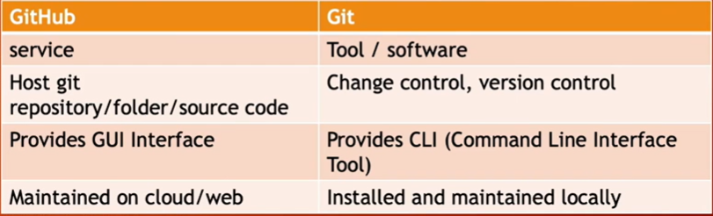
Version Control Systems (VCS)
Easily Management of working codes
Unlimited number of developers
Revert Back your files

Slide 3
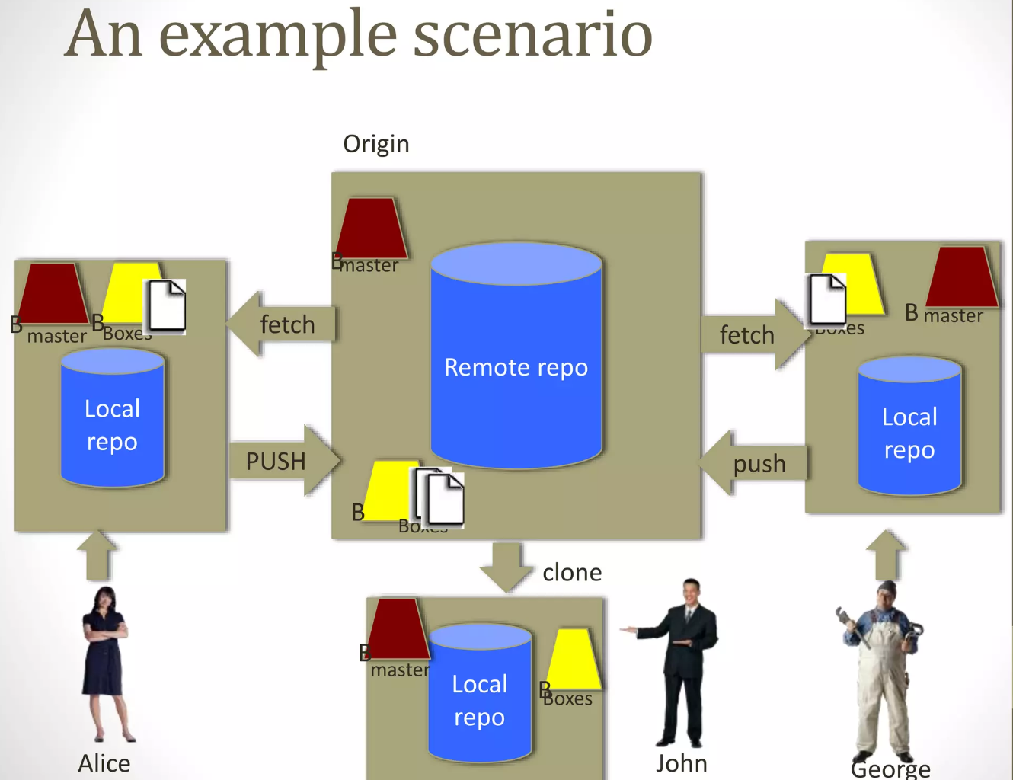
GIT

Slide 4
GIT
About | Free and open source distributed system No centralized connectivity is needed
 | Powerful and cheap branching with easy to merge Loosing work in your project is really hard
When | 2005
How | Download: https://git-scm.com/downloads
Check Version | git - - version
List all Config value | git config - -list
Query single key | git config section.key or git config section.subsection.key git config user.name

Slide 5
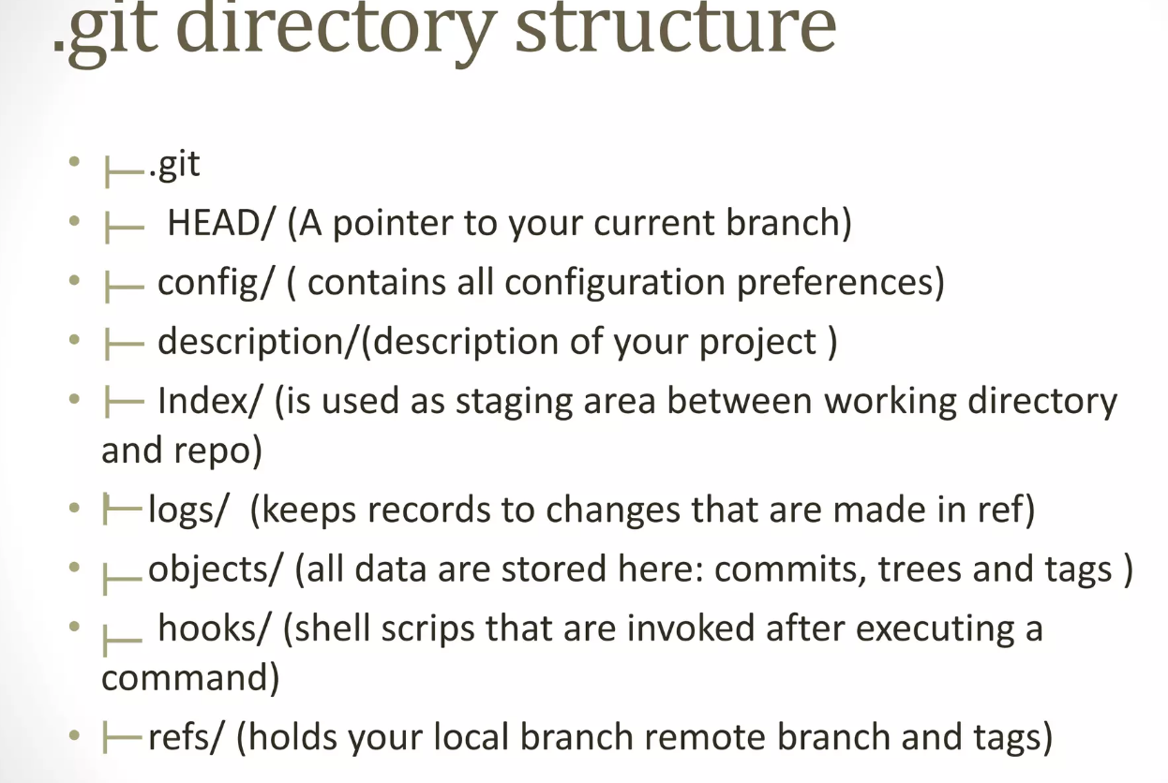
GIT directory Structure

Slide 6
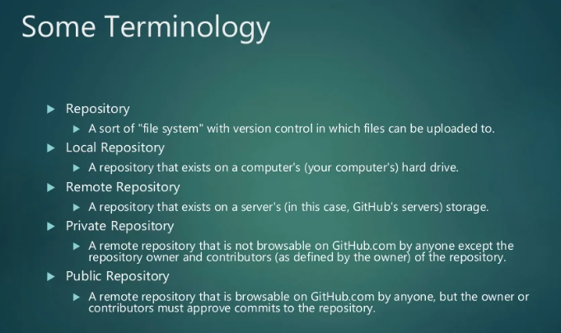
GIT directory Structure

Slide 7
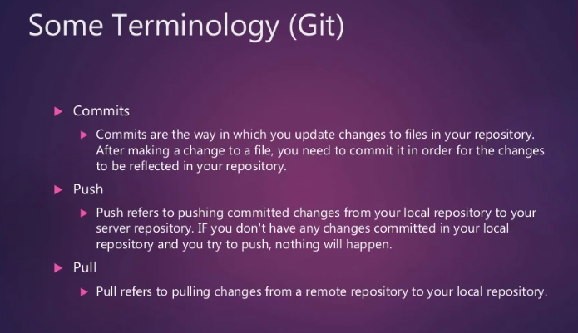
GIT directory Structure

Slide 8
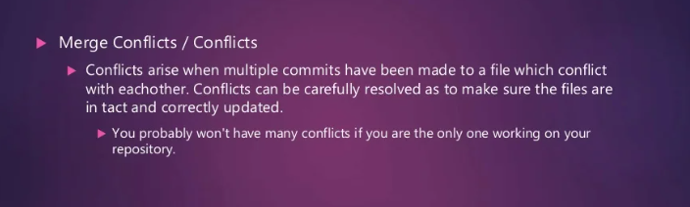
GIT directory Structure

Slide 9
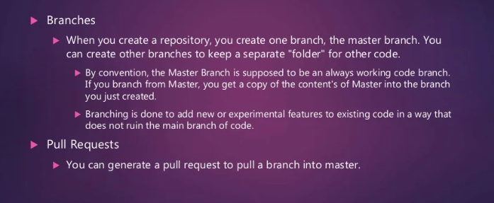
GIT directory Structure

Slide 10
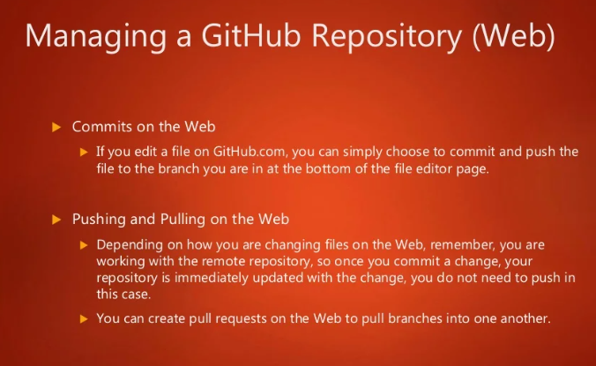
GIT directory Structure

Slide 11
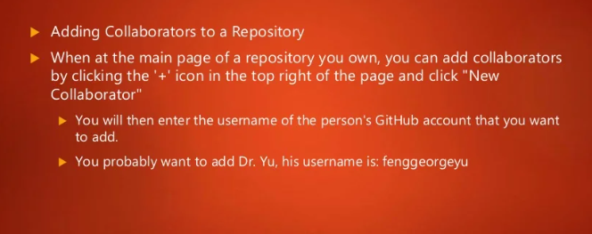
GIT directory Structure

Slide 12
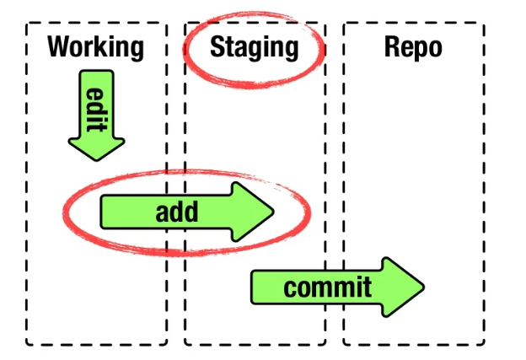

Slide 13
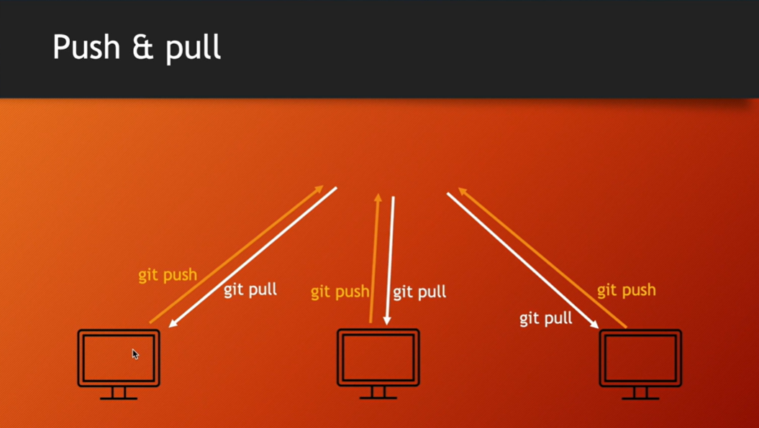

Slide 14
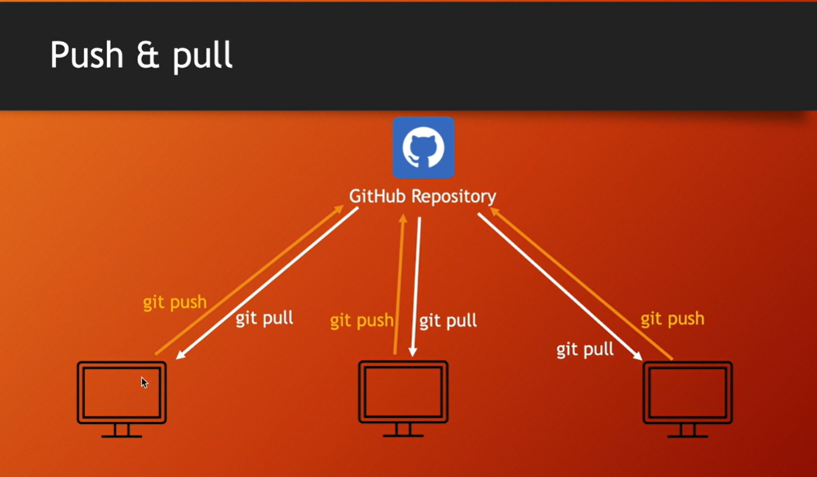

Slide 15
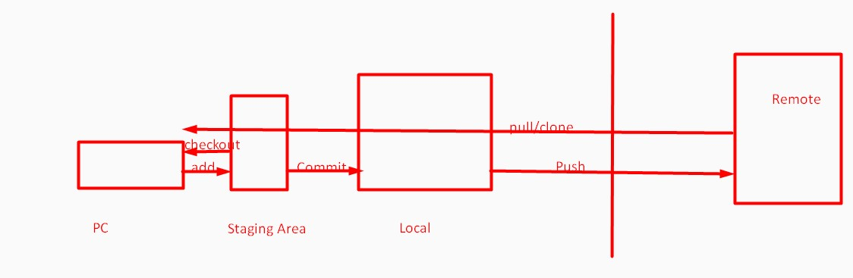

Slide 16
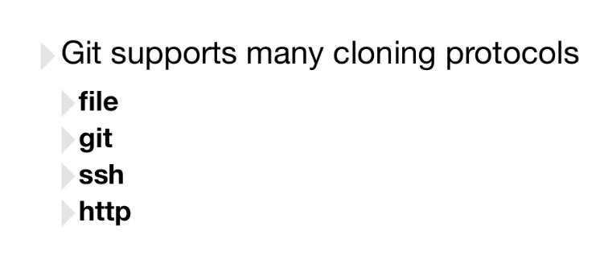

Slide 17
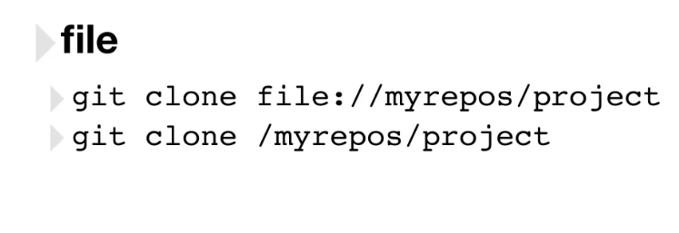

Slide 18
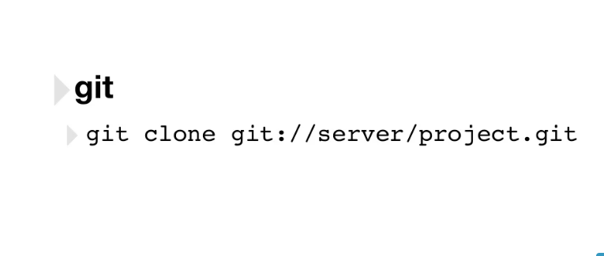

Slide 19
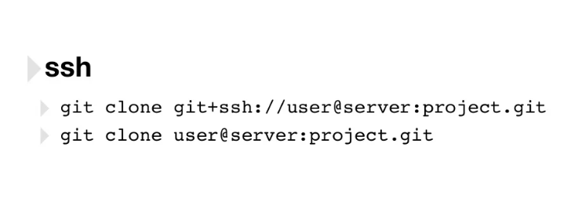

Slide 20
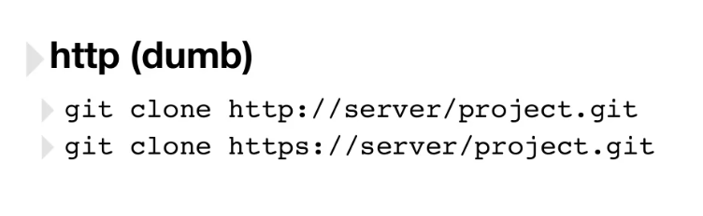

Slide 21
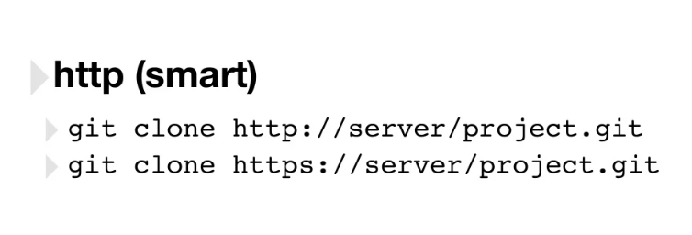

Slide 22
GIT common commands
INIT
CLONE
STATUS
ADD
CHECKOUT
COMMIT
LOG
REMOTE
FETCH
PUSH
PULL

Slide 23
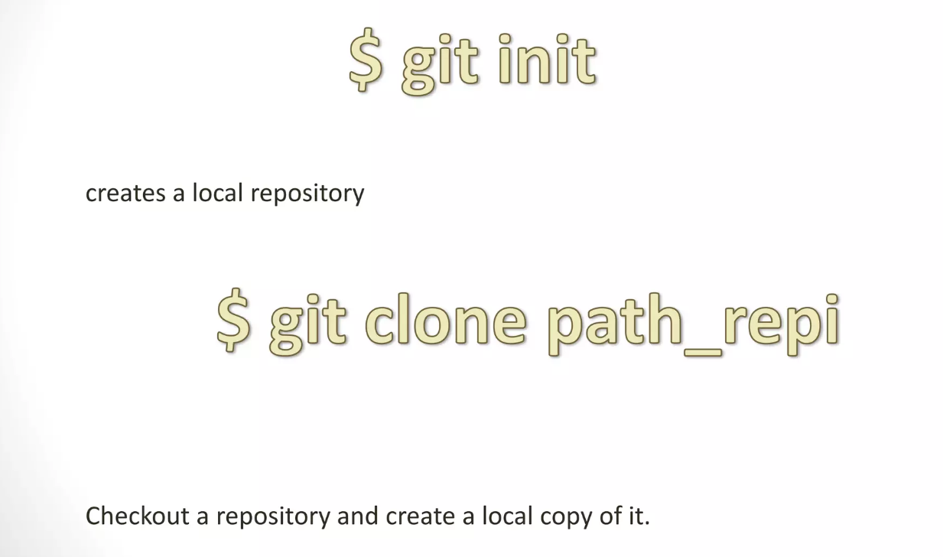
GIT Commands

Slide 24
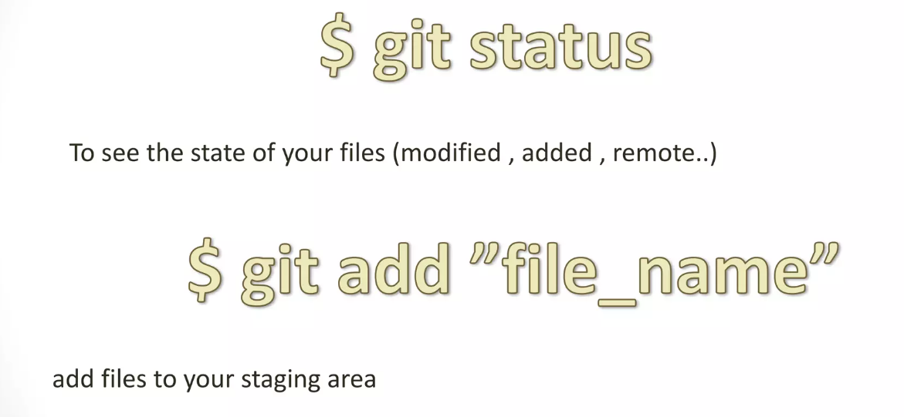
GIT Commands

Slide 25
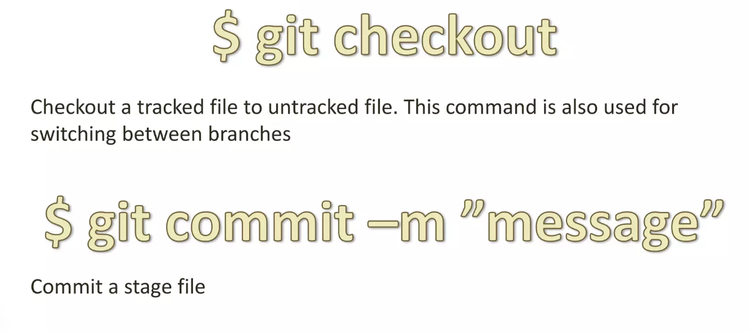
GIT Commands

Slide 26
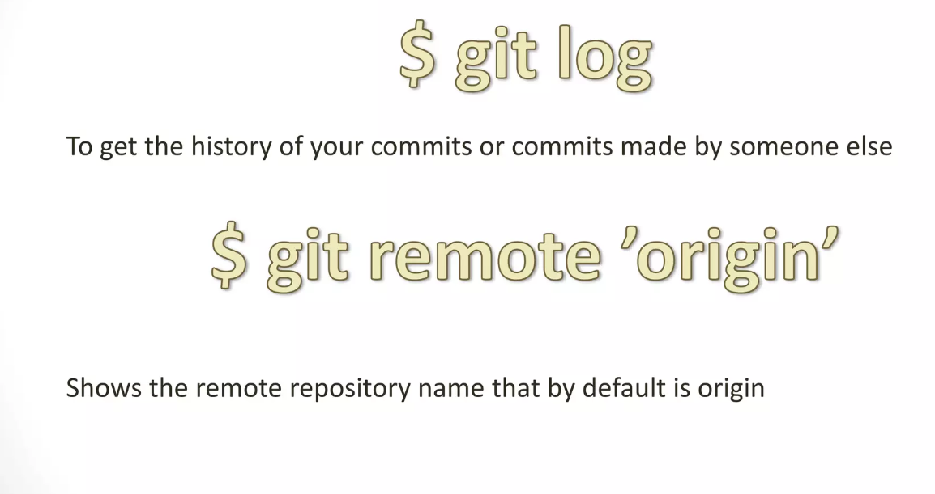
GIT Commands

Slide 27
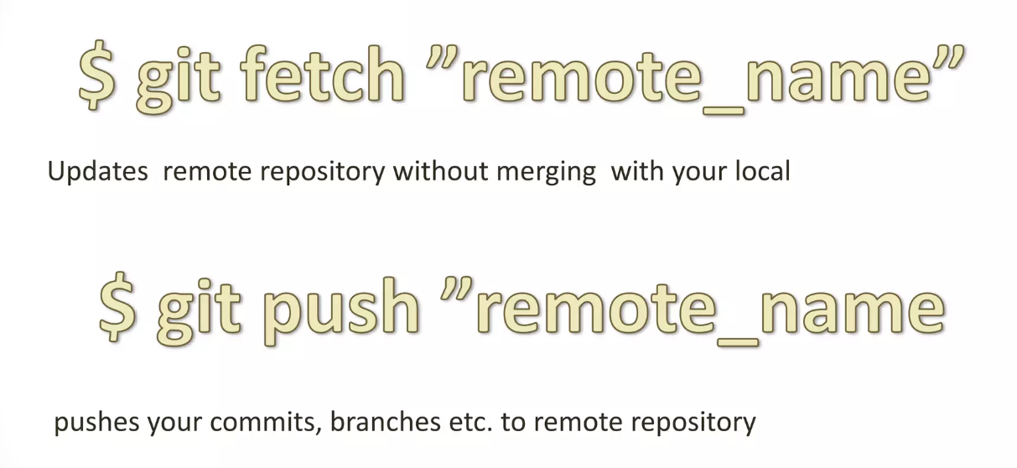
GIT Commands

Slide 28
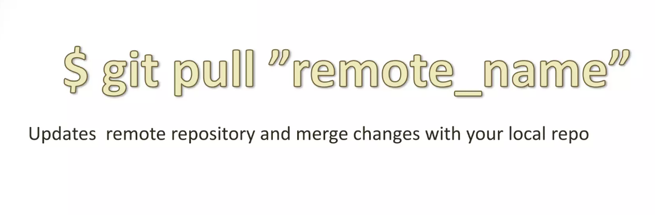
GIT Commands

Slide 29
GIT branching
1 | Lightweight movable pointers for different commits.
2 | By default the branch name is called “Master”
3 | You can create as many branch as you need, merge them or delete as you need
4 | Merging is easy.

Slide 30
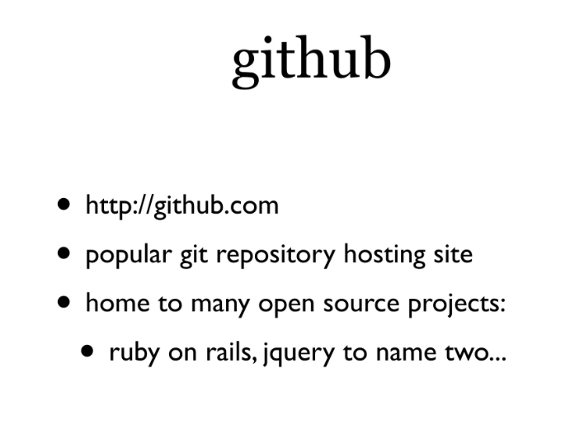
github

Slide 31
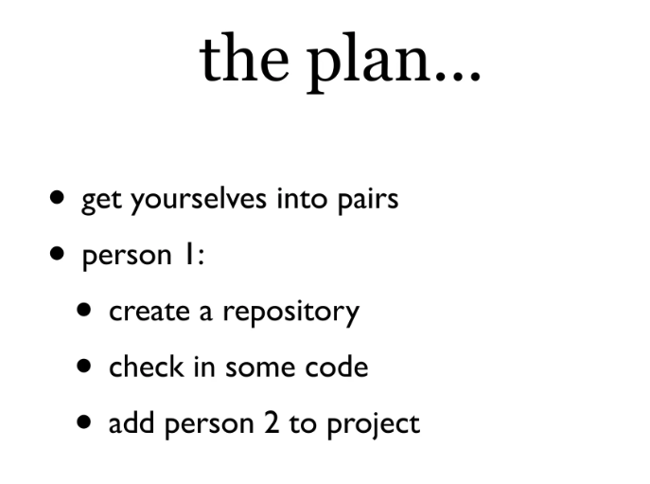
github

Slide 32
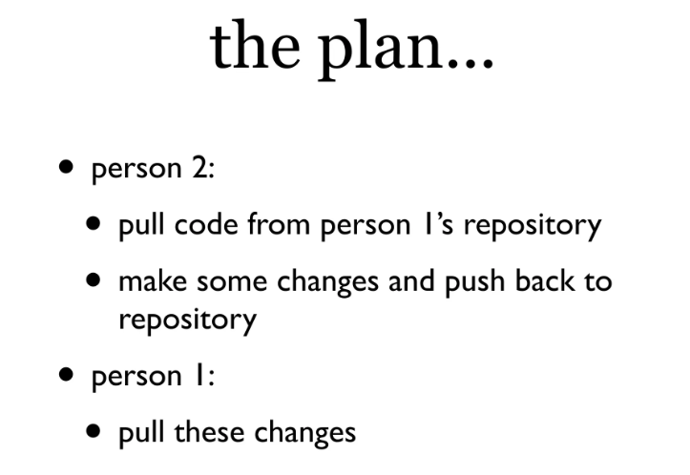
github

Slide 33
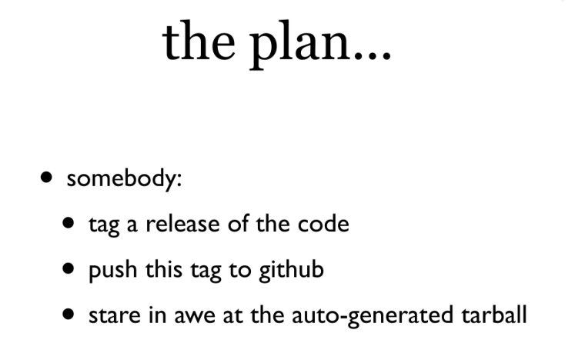
github

Slide 34
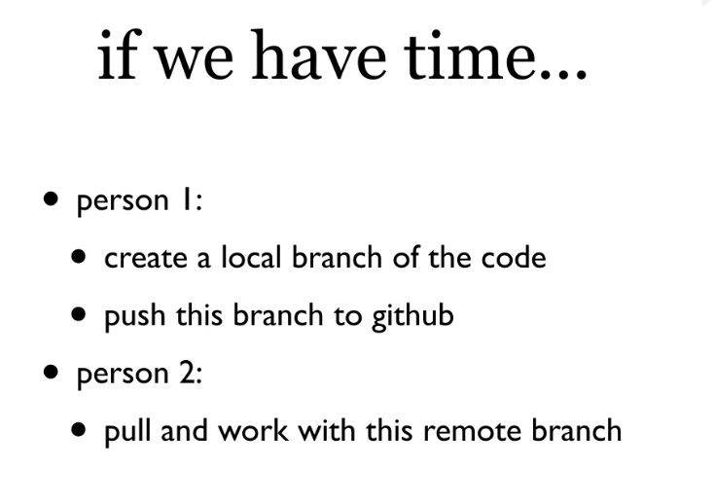
github

Slide 35
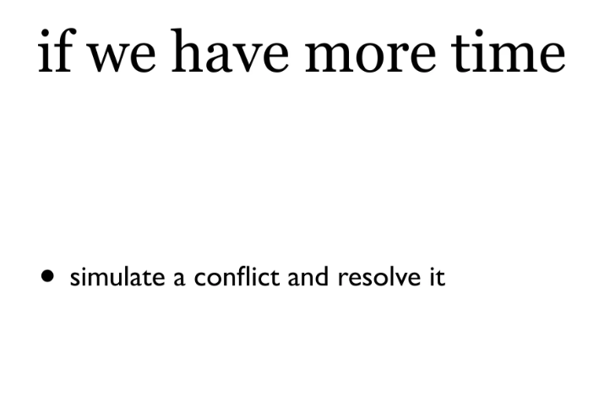
github

Slide 36

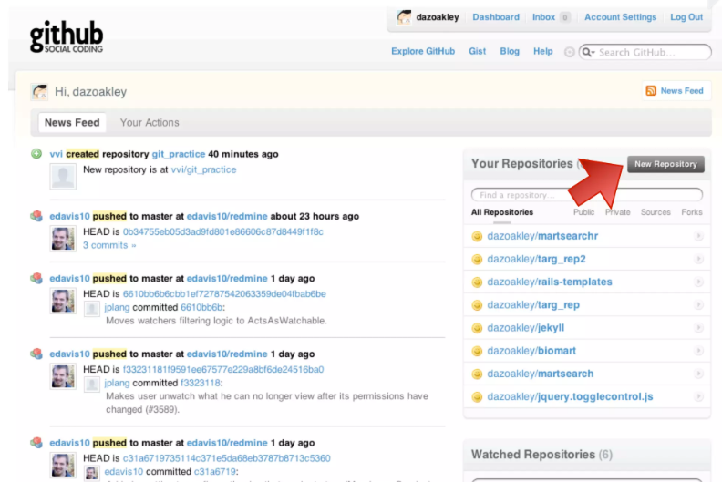
github

Slide 37
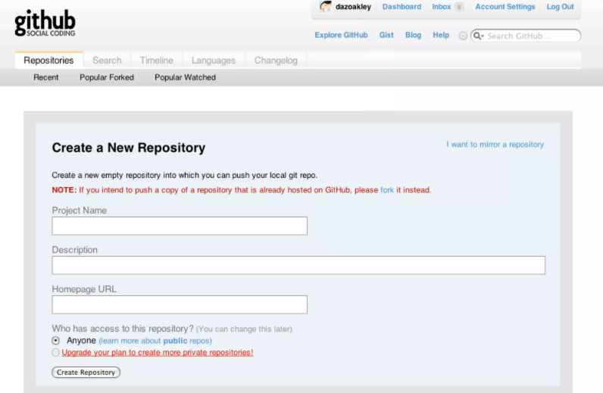
github

Slide 38
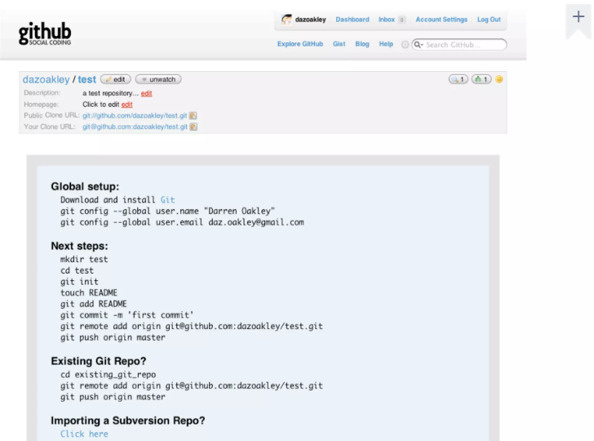
github

Slide 39
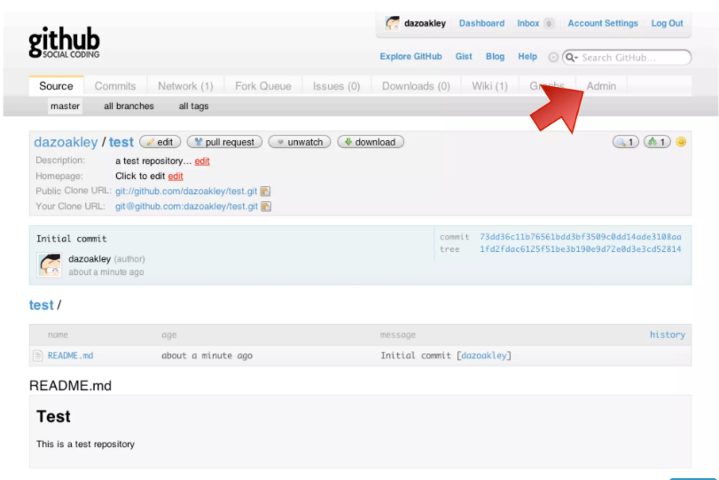
github

Slide 40
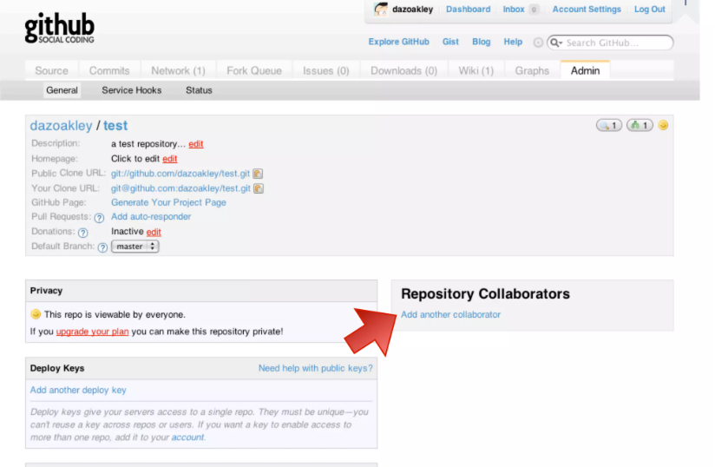
github

Slide 41
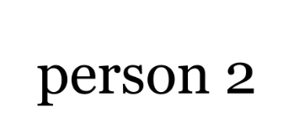
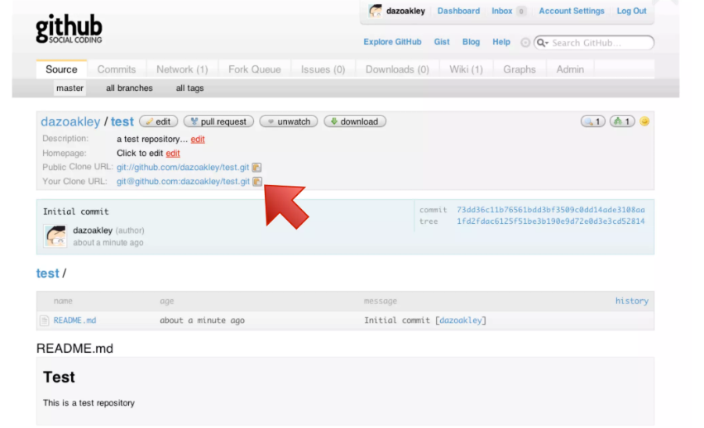
github

Slide 42
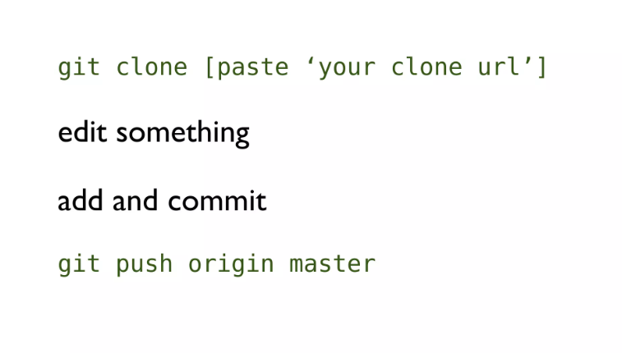
github

Slide 43
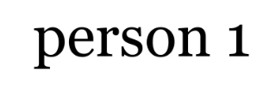
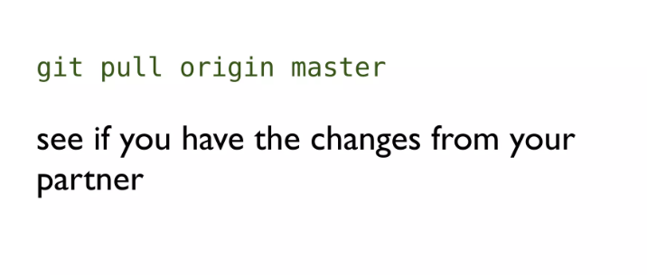
github

Slide 44

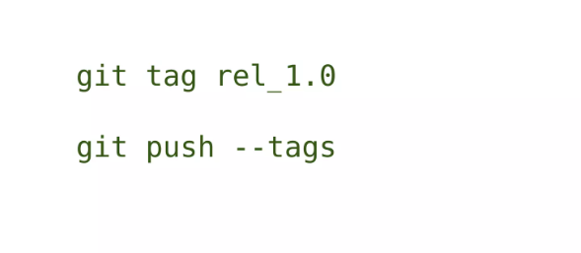
github

Slide 45
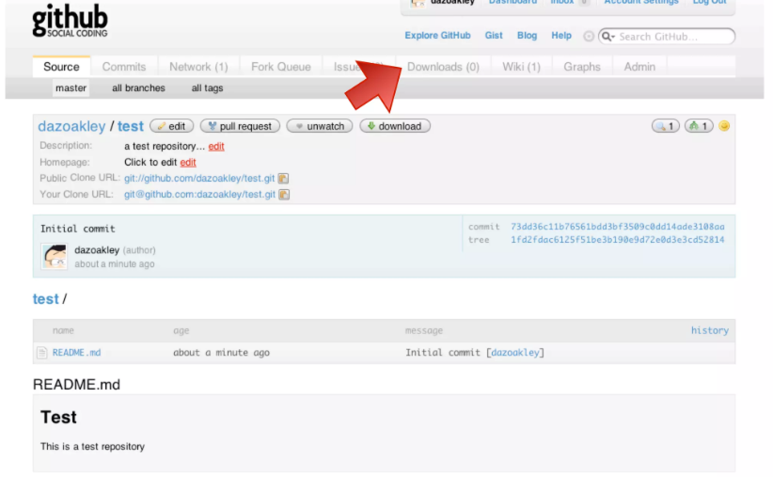
github

Slide 46
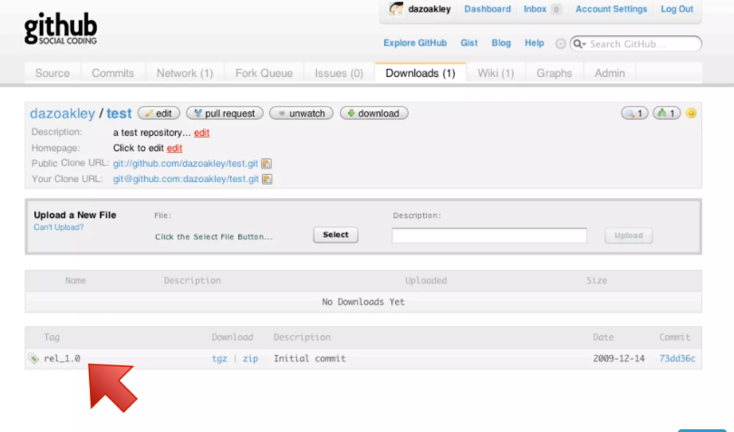
github

Slide 47

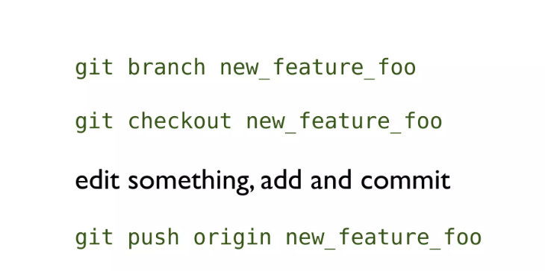
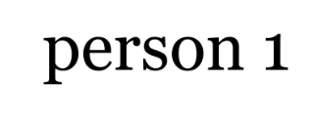
github

Slide 48
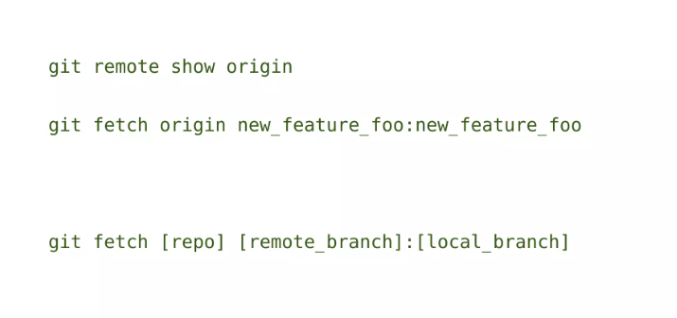
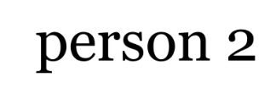
github

Slide 49
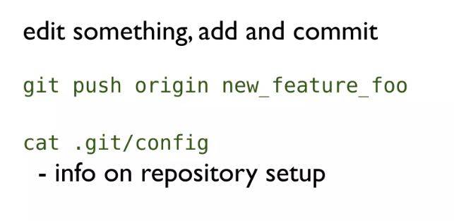
github

Slide 50
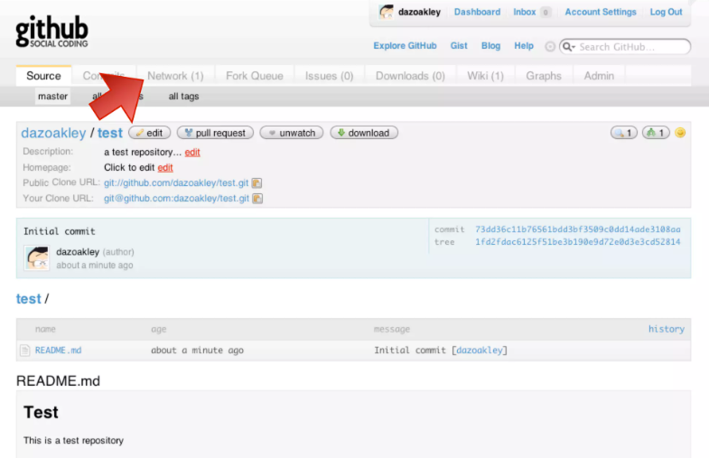
github

Slide 51



github

Slide 52

github

Slide 53

github

Slide 54


github

Slide 55

github

Slide 56

github

Slide 57

Merge conflict

Slide 58

Merge conflict

Slide 59

Merge conflict

Slide 60

Merge conflict

Slide 61

Merge conflict

Slide 62

Merge conflict

